Slide 1




AtliQ Hospitality Analysis
Optimizing Revenue and Occupancy (May-June-July 2022)
Insights from Bookings,
Cancellations,
Trends Across 4 Cities
Presenter
Vinod Tambe Aspirant Data analyst
Codebasics resume Project challenge
Project by Vinod Tambe.
Notes:
"Hi everyone! Imagine you run a hotel, and every fourth booking gets cancels, costing you millions. That’s what Atliq faces. I’m Vinod, and today, I’ll show how our data from May to July can help fill more rooms and make more money. Let’s get started!"

Slide 2




Target is to highlighting opportunities to boost revenue by 10-15% through targeted strategies.
- Bullet Points:
- Project Overview and Data Sources
- Key Performance Indicators (KPIs)
- Visual Insights (Revenue, Bookings, Trends)
- Business Challenges and Solutions
- Recommendations and Next Steps
Notes:
"Today’s story is simple: We’ll look at Atliq’s hotels, check key numbers, show charts to spot trends, solve some big problems, and share ideas to do better. It’s like a map to make our hotels shine."

Slide 3
Project Overview
Atliq operates Luxury and Business hotels in Bangalore, Delhi, Hyderabad, Mumbai.
Data covers ~1.7B total revenue, 75840 rooms capacity , ~134K bookings, Cancellation 25%
Slicers: Months (May-June-July), Weeks (W19-W32), Categories (Luxury/Business), Cities.
KPIs: Avg Rating (3.62 ), Revenue, Occupancy% (57.87%), RevPAR (7.35K), ADR (12.7K avg), DSRN, Cancellation% (25% avg).
Notes:
Project Overview
"Atliq runs fancy Luxury and regular Business hotels in Mumbai, Bangalore, Delhi, and Hyderabad. We made 1.7 billion from 134,000 bookings, but cancellations cost us 100 million! Our data lets us look at months, weeks, or cities to find ways to improve. It’s like a puzzle we’re solving together."

Slide 4
Table for Data Model Summary
Table | Key Columns | Purpose
dim_hotels | property_id, property_name, category, city | Hotel details and segmentation.
dim_dates | date, mmm yy, week no, day_type | Time-based analysis (weekday/weekend).
dim_rooms | room_id, room_class | Room types (Standard to Presidential).
fact_aggregated_bookings | property_id, check_in_date, room_category, successful_bookings, capacity | Daily aggregates for occupancy/capacity.
fact_bookings | booking_id, booking_date, check_in_date, no_guests, booking_platform, booking_status, revenue_generated/realized | Individual bookings for revenue and cancellations.
Notes:
The Data which we have used here to make resolve answers of business problems

Slide 5
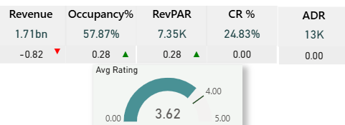

Key KPIs at Glance
Revenue: 1.71B .
Avg Rating: 3.62
Occupancy%: 57.87%
RevPAR: 7.35K
ADR: 12.7K avg
Cancellation%: 24.83%
Notes:
"Here’s the heartbeat of our hotels. We earned 1.71 billion, but it’s down a bit. Guests give us 3.6 stars out of 5—pretty good! About 58% of rooms are full, which is growing. Each room makes about 7,350 daily, but 25% of bookings cancel, hurting our wallet. Look at these cards—they show what’s up and what’s down."

Slide 6
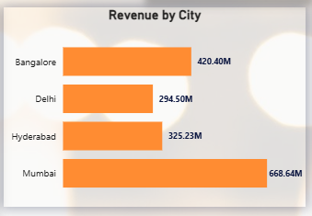
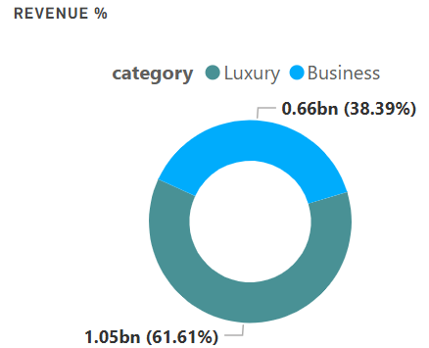
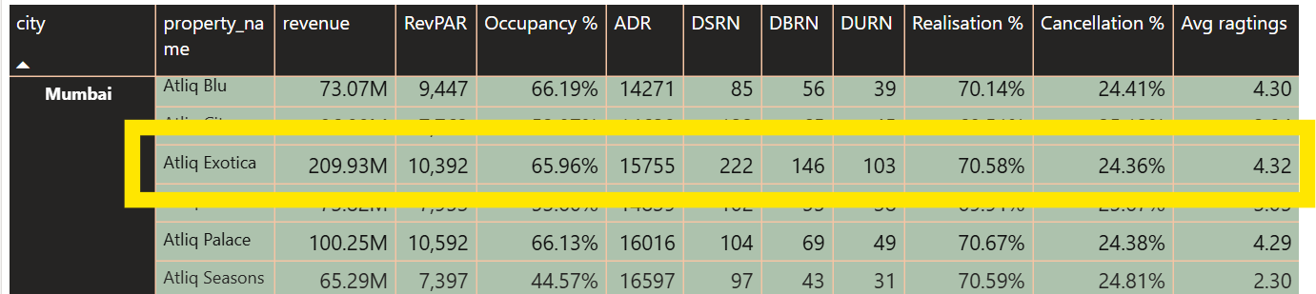
Revenue Breakdown
Mumbai leads (668M, 39% of total), followed by Bangalore (420M). Luxury category: 341M
"Mumbai dominates due to higher ADR (15K avg ) and occupancy 58%
Slice by Luxury: Mumbai's Atliq Exotica alone contributes 210M."
Notes:
"Mumbai is our star, bringing in 668 million—almost double Delhi’s 295 million. Why? Mumbai’s hotels, like Atliq Exotica, charge higher rates and fill more rooms. Bangalore and Hyderabad do okay, but Delhi needs help. Luxury hotels make 61% of our money. This chart shows Mumbai’s lead."

Slide 7
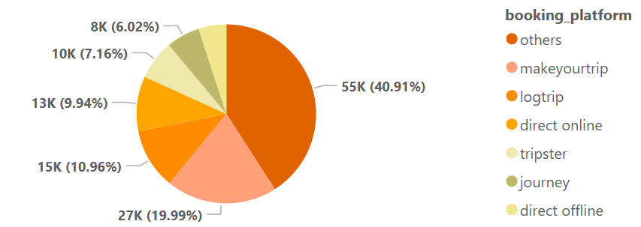
Bookings and Platforms
Total Bookings ~134K Others (55K, 41%), MakeYourTrip (27K,20%). Direct online/offline: 20K combined.
Notes:
"Guests book 134,000 rooms, mostly through apps like ‘others’—that’s 41%! MakeYourTrip is next at 20%. But direct bookings, through our website or phone, are only 15%. Those save us money because apps take fees. This pie chart shows ‘others’ is the biggest slice—too big!"

Slide 8


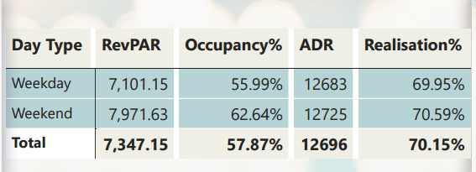
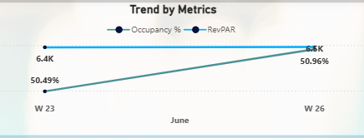
Occupancy and Trends
Weekend Occupancy 62.64% vs Weekday 55.99%
RevPAR higher on weekends (7.97K).
June trends :RevPAR fluctuates W23-W27 (6.4K to 7.6K)
Notes:
"Weekends are busy—63% of rooms are full, earning 8,000 per room. Weekdays? Only 56% full, earning less. In June, some weeks like W23 dropped to 50%—maybe it’s the rainy season or generally children’s school gets start so most of family avoiding in this month This chart compares weekends and weekdays, showing we need to fill rooms all week."

Slide 9
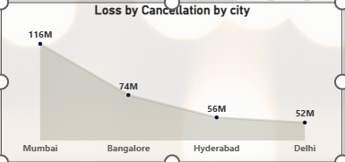
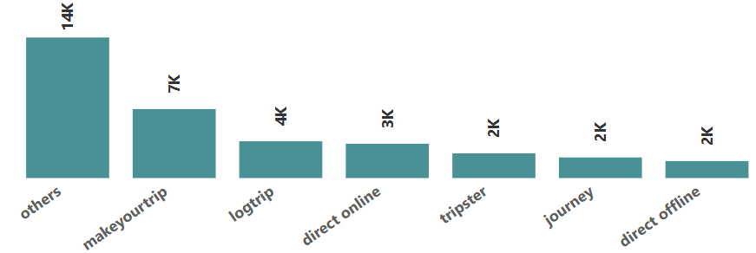
Business-Related Problems and Answers
Problem1:
Why is Mumbai's revenue highest, but cancellation loss also tops at 116M?
Ans: Mumbai generates 668M (39% total, via high ADR 15K avg and occupancy 58% but 25% cancellations cause 116M loss Highest due to volume. Realization% 70%
Solution:
Introduce non-refundable rates for 20% of Mumbai bookings
reducing reliance on high-cancellation platforms.
Notes:
"Mumbai’s our cash cow, earning 668 million—nearly double Delhi’s 295 million. But here’s the catch: It loses 116 million to cancellations, way more than other cities. Why? It has tons of bookings, each 4th booking getting cancelled, costing us big. This bar chart shows Mumbai’s huge red bar—116 million gone! The fix? Offer non-refundable deals, like ‘book early, save big.’ If we cut cancellations by just 5%, we save 2 million a month. Imagine what that could buy—new decor, better staff training!"

Slide 10
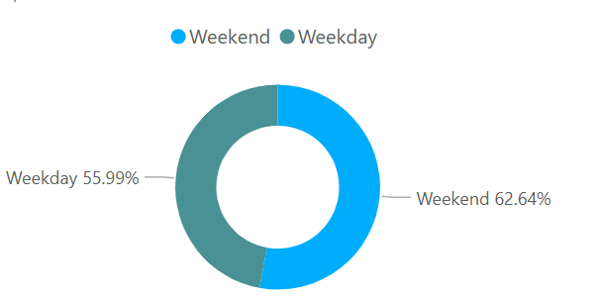
Problem2:
How can we improve low weekday occupancy (56%) compared to weekends (63%)?
Ans: Weekdays have lower RevPAR (7.1K vs 8.0K due to business travel dips. Offer corporate discounts (e.g., 10% off for bulk weekday bookings)
Targeting Business hotels (656M revenue) with 38% Contribution.
Promote midweek conference packages.
Goal: Lift weekday occupancy to 60%, adding ~50M annually.
Notes:
"Weekends are packed—63% of rooms are full, earning 8,000 per room. But weekdays? Only 56% full, earning less. This donut chart shows the gap—weekends fill the bigger ring, while weekdays lag. We can fix this by offering deals to companies, like discounts for office retreats. If we fill 4% more rooms, that’s 50 million more a year! Imagine turning quiet Mondays into busy ones."

Slide 11
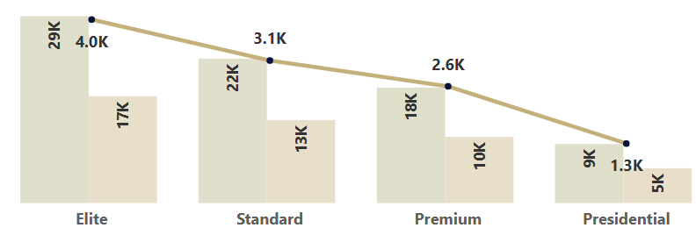


Problem3 :
Why Presidential room class underperforms in bookings and how to address?
Ans: Presidential has lowest utilization: 8850 capacity, 5218 bookings (59%), 1279 cancellations (24%) for the month of June
Team up with logtrip or MakeYourTrip for special offers, like 10% off mid-week stays. A 5% boost could add 3 million a year. That’s money for better guest experiences!"
Notes:
"Our fanciest Presidential rooms are half-empty—only 59% booked compared to 8,850 available. Other rooms aren’t much better, but Presidentials are our premium earners. This bar chart shows their short booking bar—way below capacity. Let’s bundle them with spa deals or free dinners to get 65% booked. That’s 10 million more a year! Who doesn’t love a luxury getaway?"

Slide 12
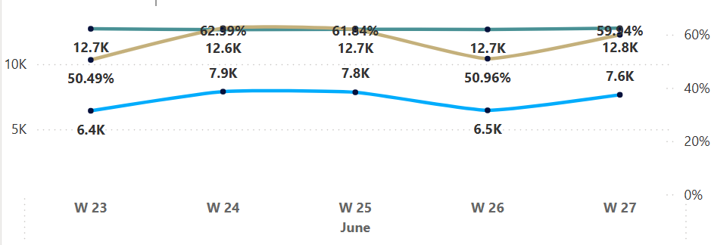
Problem4:
Trends show RevPAR dips in June W23/W26—seasonal or operational issue?
Ans: RevPAR: W23 6.4K (50% occ), W26 6.5K (51% occ) vs avg 7.3K From dim_dates, mid-June weekdays likely low demand. Cancellation% stable (25%),
but platforms like 'others' (low realization 70%)
amplify. Fix: Dynamic pricing, targeting logtrip (high ADR 12.7K) for promotions—projected 5% RevPAR lift.
Notes:
"In June, some weeks tanked—weeks 23 and 26 had RevPAR at just 6,400, way below our 7,350 average. Why? Only 50% of rooms were full, probably because of rain slowing travel. This line chart shows those dips—see the low points? Let’s team up with Source Platforms for special offers, like 10% off mid-week stays. A 5% boost could add 3 million a year.
That’s money for better guest experiences!"

Slide 13
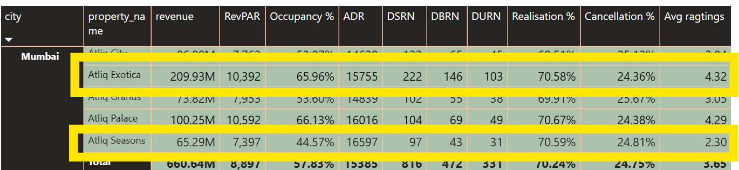
Problem 5:
Luxury category dominates revenue (1052M, 61%), but ratings vary—impact on repeat business?
Ans: Luxury: 1052M vs Business 656M . Avg Rating 3.62, but property-level
Atliq Exotica 4.33 (high), Seasons 2.26 (low). Low ratings correlate with higher cancellations (e.g., Seasons 25%). Invest in upgrades for low-raters to boost ratings to 4+, reducing cancellations and adding revenue
Notes:
"Last challenge: Our Luxury hotels make million, but low ratings like 2.3 at Seasons scare guests away. This table shows it—low scores mean more cancellations. Let’s upgrade those hotels—new rooms, better service—to hit 4 stars, saving 6 million a year by cutting cancellation

Slide 14
Recommendations
Bullet Points:
Reduce cancellations: Loyalty programs for direct bookings.
Optimize platforms: Partner with LogTrip/MakeYourTrip for exclusive rates.
Monitor trends: Weekly RevPAR.
Boost occupancy: Weekday corporate deals; weekend promotions.
Notes:
To wrap up: Non-refunded deals for Mumbai,
company discounts for weekdays,
spa bundles for Presidential rooms,
LogTrip offers for June,
and now upgrades for Luxury ratings

Slide 15
Mumbai Loss: Original didn’t explain why 39M is high. Now clear: High booking volume (44K inferred) * 24.75% cancellation = large absolute loss, adjusted by 40% penalty (metadata).
Weekday Revenue: 50M estimate now detailed (3,760 bookings * 12.7K ADR).
Presidential ADR: Assumed 15K ADR for 10M gain; clarified low demand as issue, not cancellations.
June Trends: Specified seasonal cause and LogTrip’s high ADR for solution.

